Slide 1


Bootstrapping blockchain
Mike Ormond, Microsoft Ltd - @mikeormond
Jonathan Collinge, Microsoft Ltd - @dotjson
"LEGO blocks (#0048)" (CC BY 2.0) by regan76 @ flickr

Slide 2
Demo Bootstrap a blockchain in Azure

Slide 3
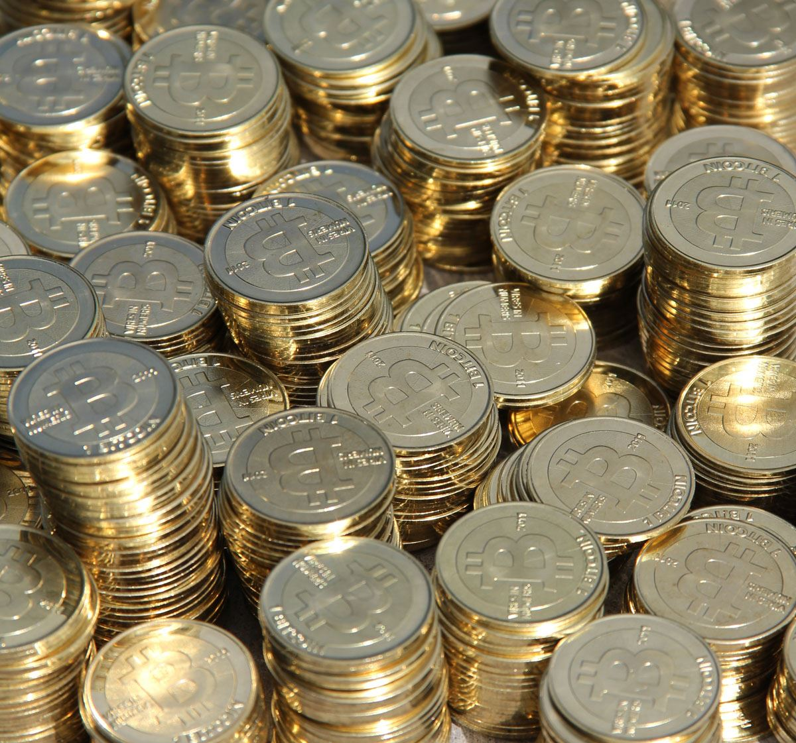
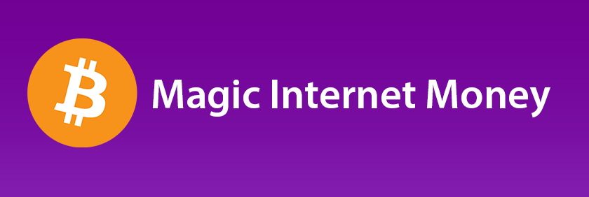
"bitcoin" (CC BY 2.0) by stevegarfield @ flickr
"bitcoin" (CC BY 2.0) by Sean MacEntee @ flickr

Slide 4

"Randy’s" (CC BY 2.0) by Extra Medium @ flickr

Slide 5

"599 HGTE." (CC BY 2.0) by Damian Morys Photography @ flickr

Slide 6

“Double Spend Problem”
"Blue And Pink Piggy Banks" (CC BY-SA 2.0) by kenteegardin @ flickr

Slide 7

What’s so special about blockchain anyway?

Slide 8

FROM | TO | TYPE | VALUE
Jim | Bob | Payment | £100
Bob | Jim | Asset | House
Alice | Jim | Message | “I love you”
Kate | Alice | Payment | £5
A | B | Something | Value
… | … | … | ...
… | … | … | …
A ledger
Image (CC BY 2.0) by Andrew_Writer @ flickr

Slide 9

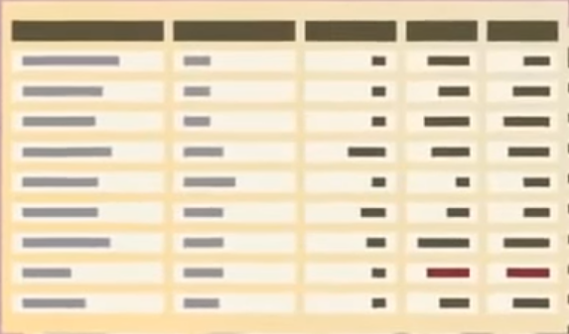
Distributed
Shared
“Sibelius Monument” by Carlos ZGZ @ flickr

Slide 10
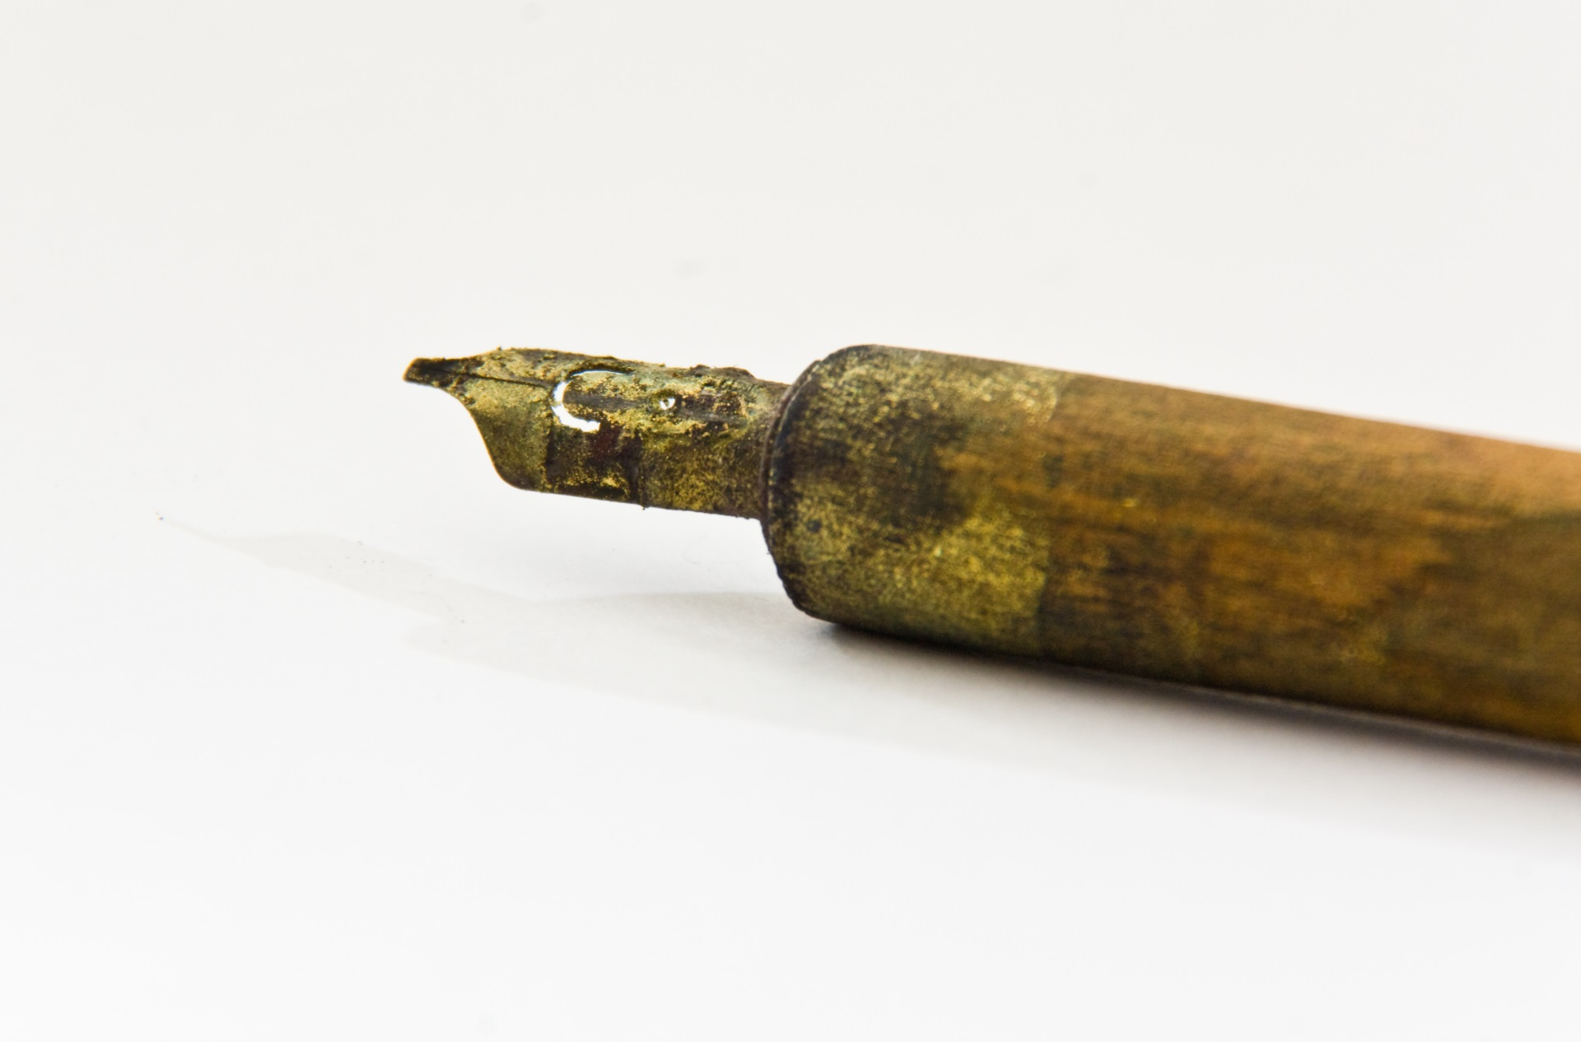
Immutable
“Written in Gold” (CC BY 2.0) by Anonymous Account @ flickr

Slide 11
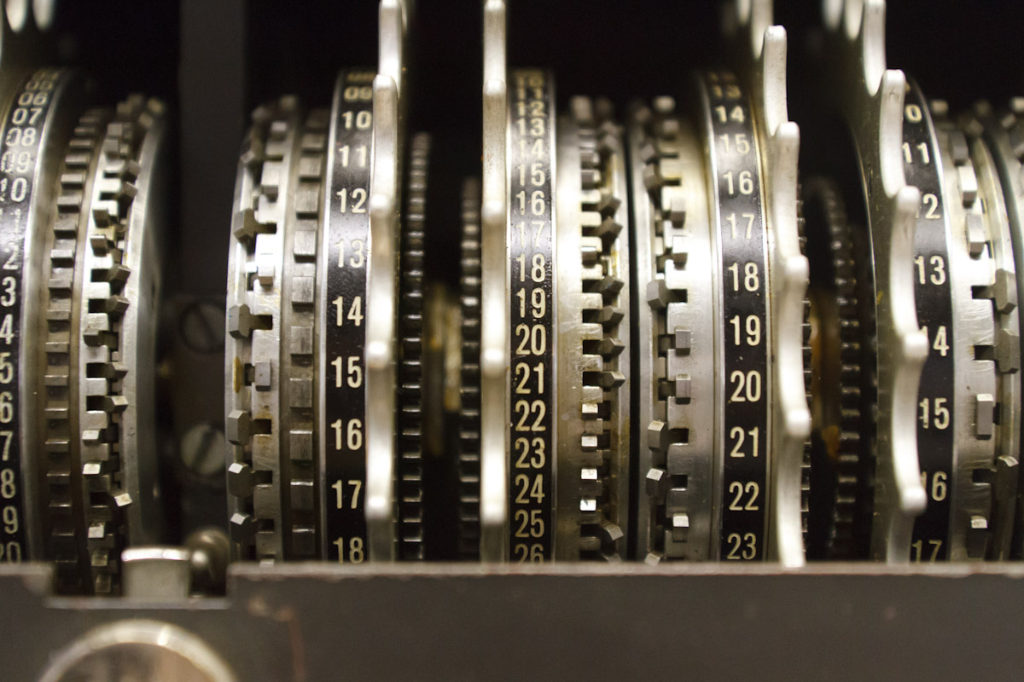
Cryptography
"Bletchley Park" (CC BY 2.0) by Cargo Cult @ flickr

Slide 12

Open
Anonymised
"Schooling" (CC BY-SA 2.0) by Benson Kua @ flickr

Slide 13
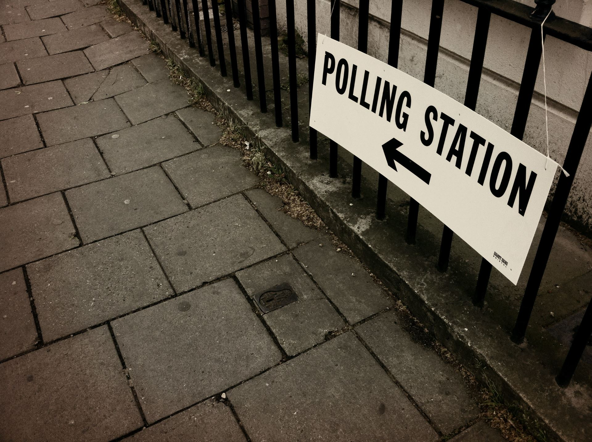
Consensus
"May 5: Vote" (CC BY-SA 2.0) by pjohnkeane @ flickr

Slide 14

Trust
"Trust" (CC BY 2.0) by schmollmolch @ flickr

Slide 15
Demo Let’s create a transaction (the hard way)

Slide 16
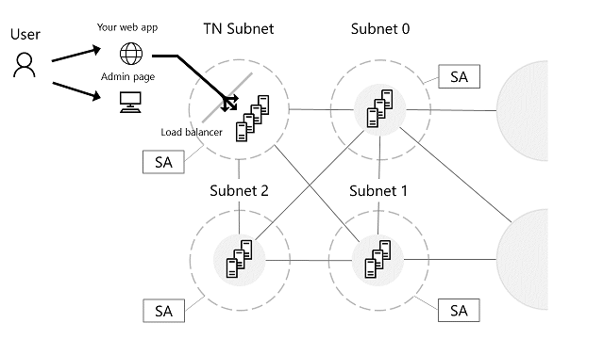
Bletchley ARM Template

Slide 17
How does it work?

Slide 18
0x4fb8…
Jeremy
0xe618…
Geoff
0x88d2…
Transaction x
0xa37dcd8d2f8bb9f…
New Block
Previous Block
0x09aa5...
Transaction 9
Transaction 8
Transaction 7
Transaction 6

Slide 19
The chain forms
Block 0 (0x23e79…)
Block 1 (0x09aa5……)
Block 2 (0x7b5…)
Genesis Block
Previous Block
0x23e79...
Previous Block
0x09aa5...
Transaction 9
Transaction 3
Transaction 8
Transaction 2
Transaction 5
Transaction 7
Transaction 1
Transaction 4
Transaction 6

Slide 20
Why should I care?

Slide 21
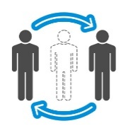
Potential for disruption
Eliminates Intermediaries
Allows industries to redefine or create new business models.
Reduces Fraud
Highly secure and transparent, making it nearly impossible to change historical records.
Increases Efficiency and Speed
Simplifies transactions and enables T+Zero settlement time.
Increases Revenue and Savings
Potential savings and new revenue opportunities through more efficient processes and reduced costs.

Slide 22

It’s not
just
about
money
"money 1" (CC BY-SA 2.0) by allenthepostman @ flickr

Slide 23
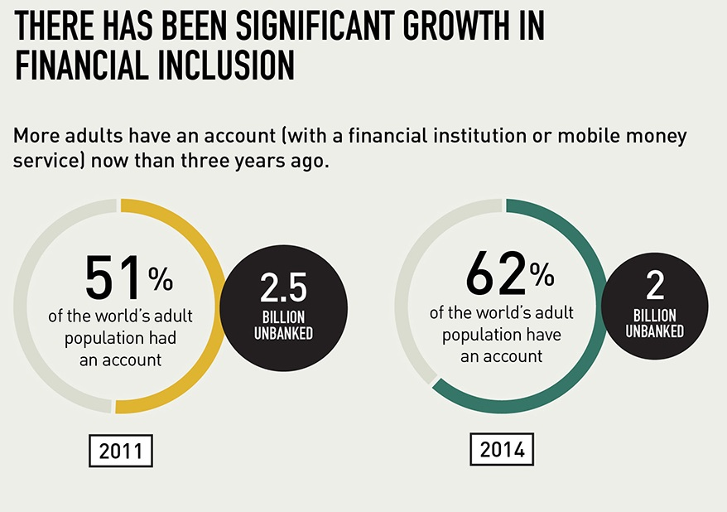
Global Findex 2014 infographic courtesy of The World Bank

Slide 24
Blockchain x.0

Slide 25
Smart Contracts
Blockchain 2.0
+ Smart Contracts
Logic Tier
Blockchain 1.0
Simple Ledgers that record transactions

Slide 26

Smart Contracts
Blockchain 3.0
+ Cloud Servicing
Multilayer Middleware
+ Cryptlets
Blockchain 2.0
+ Smart Contracts
Logic Tier
Blockchain 1.0
Simple Ledgers that record transactions

Slide 27
Ethereum Platform
“Next generation” blockchain – fully trustless smart contract platform
Ether is the “currency” of Ethereum
Ethereum Virtual Machine (EVM) – Turing Complete
Ethereum client eg go-ethereum (or Geth), Parity, cpp-ethereum
Ethereum wallet / Mist

Slide 28
Ethereum Development
Geth (client) allows us to deploy and exercise smart contracts
Geth exposes API over JSON-RPC
Web3.js SDK wraps API for JS (also .NET, Java, Ruby SDKs)
Solidity is the language -> compiled to bytecode for deployment
Truffle development framework
testrpc is a local Ethereum client for testing

Slide 29

Dev Cycle
Blockchain Network
Authoring
(VS Code)
Local Ethereum
Node
(testrpc)
Truffle
Compile
Deploy
Network Ethereum
Node
(Geth)
Truffle
Compile
Deploy

Slide 30
Demo Solidity and Smart Contracts

Slide 31
Types of blockchain

Slide 32
Public vs Consortium
Public
Unpermissioned (eg Bitcoin, Ethereum)
Anyone has access
No single owner – all participants are “owners”
Anyone can verify transactions and consensus is used to determine “truth”
Consortium
Permissioned Public (eg Ripple)
Anyone has access
One or many “owners”
Only designated actors can verify transactions and achieve consensus
Permissioned Private (eg Bankchain)
Access to the ledger is restricted
One or many “owners”
Only designated actors can verify transactions and achieve consensus

Slide 33
Consensus Forming Approach
Consensus requires participants with vested interest
Proof of work (need to solve a puzzle)
Proof of stake (I can demonstrate I own some stake in the system)
Proof of burn (I’m prepared to make a sacrifice to participate)
It must come at a cost but be easy to verify (asymmetric)

Slide 34
Potential applications

Slide 35



It will disrupt multiple industries
Financial
Redesign costly legacy workflows, improve liquidity and free up capital. Help reduce infrastructure costs, increase transparency, reduce fraud and improve execution and settlement times.
Healthcare
Removes third-party verifiers such as health information exchanges by directly linking patient records to clinical and financial stakeholders. Provides fast, secure, authenticated access to personal medical records across healthcare organizations and geographies.
Government
Increase transparency and traceability of how money is spent. Track asset registration, such as vehicles. Reduce fraud and operational costs.
Retail & Manufacturing
Better supply chain management, smart contract platforms, digital currencies, and tighter cybersecurity.

Slide 36
Microsoft and blockchain

Slide 37




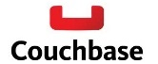
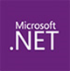









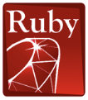







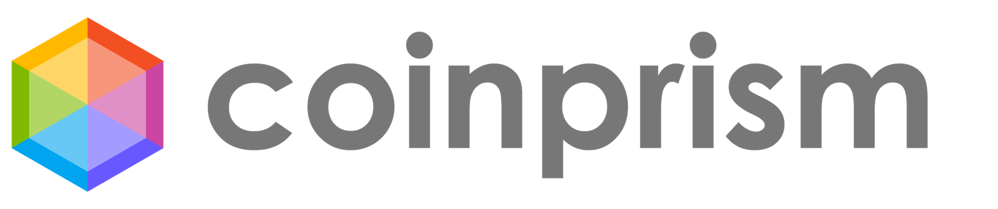


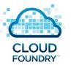







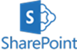



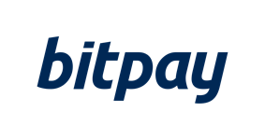









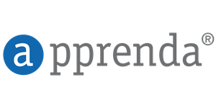




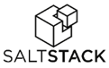

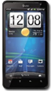


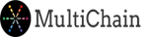

Microsoft Azure | An Open Cloud
Infrastructure
Databases
App Frameworks
Hyper Scale
Enterprise Grade
Hybrid
We’ve delivered an open, broad, and flexible cloud across the stack
SQL Server
Azure BaaS
+Hundreds of community supported images on VM Depot
Applications
Management
Clients
Web App Gallery
Dozens of .NET & PHP CMS and Web apps

Slide 38













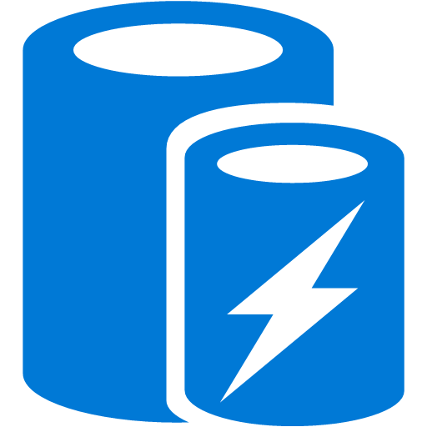




















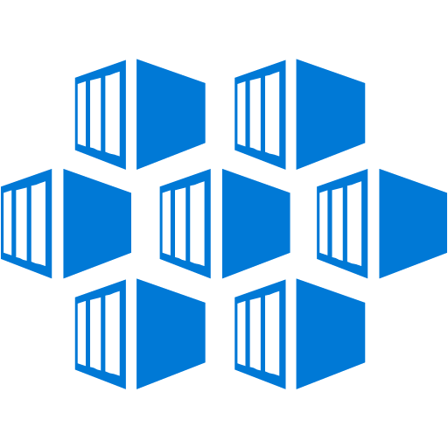

























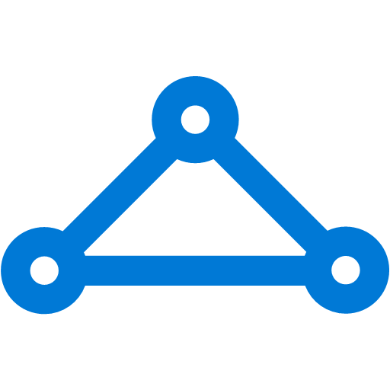


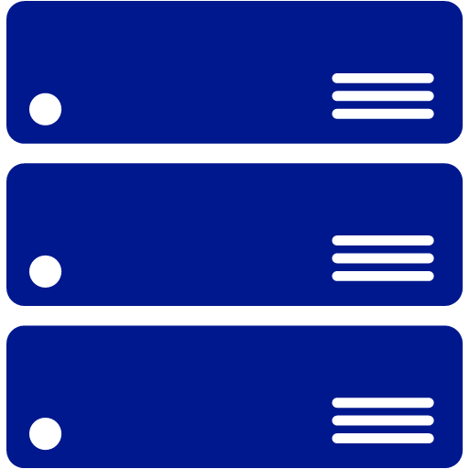
Platform Services
Security & Management
Hybrid
Cloud
Media & CDN
Application Platform
Data
Security Center
SQL
Database
Azure AD
Health Monitoring
Media Services
Media Analytics
Content Delivery
Network
Web
Apps
Mobile
Apps
SQL Data
Warehouse
DocumentDB
Portal
AD Privileged
Identity
Management
Azure Active
Directory
Integration
SQL Server
Stretch Database
Redis
Cache
Storage
Tables
Azure
Search
API
Apps
Cloud
Services
Azure AD
B2C
API
Management
BizTalk
Services
Domain Services
Service
Fabric
Notification
Hubs
Intelligence
Multi-Factor
Authentication
Logic
Apps
Service Bus
Functions
Cognitive Services
Bot Framework
Cortana
Backup
Automation
Developer Services
Analytics & IoT
Operational
Analytics
Compute Services
Scheduler
HDInsight
Machine
Learning
Stream Analytics
Container
Service
VM
Scale Sets
Visual Studio
Mobile
Engagement
Import/Export
Key Vault
Data
Catalog
Data Lake
Analytics Service
Data Lake Store
Store/
Marketplace
Batch
RemoteApp
VS Team Services
Xamarin
Azure Site
Recovery
Application
Insights
HockeyApp
IoT Hub
Event
Hubs
Data
Factory
Power BI
Embedded
VM Image Gallery
& VM Depot
Dev/Test Lab
StorSimple
Infrastructure Services
Compute
Storage
Networking
Virtual Machines
Containers
Blob
Queues
Files
Disks
Virtual Network
Load Balancer
DNS
Express
Route
Traffic Manager
VPN Gateway
App
Gateway
Datacenter Infrastructure (32 Regions, 24 Online)

Slide 39




Our three part Project Bletchley strategy
POCs
Build and learn
Banking, Capital Markets
Discrete Manufacturing
Retail & CPG
Healthcare
Government
Professional Services & Support
Industry Solutions
Horizontal SaaS & Adapters
1st Party
3rd Party
3rd Party
3rd Party
…..
Develop key Azure middleware services
Distributed Ledger Gateway Services
Identity & Key Services
Encryption Services
ML & BI
Services
Middleware
Crypto services & architecture (secure containers, attestation, etc.)
Grow the ecosystem
Smart Contract-Based Distributed Ledger Stacks
UTXO + others
Blockchain Virtual Machine
Adapters
Base Platform
1st party DL Stack
3rd party DL stack A
3rd party DL stack B
3rd party DL stack C…
Azure – Blockchain resource provider

Slide 40
Demo Blockchain vote-off

Slide 41

Blockchain Network
React.js
+
Web3.js
Geth
TX node
Web Server

Slide 42
Get started
SIGN UP FOR AN AZURE ACCOUNT
https://azure.microsoft.com/
READ ABOUT BLOCKCHAIN ON AZURE
https://azure.microsoft.com/en-gb/solutions/blockchain/
TRY THE CONSORTIUM BLOCKCHAIN TEMPLATE
https://azure.microsoft.com/en-us/blog/project-bletchley-blockchain-infrastructure-made-easy/
FIND OUT MORE ABOUT PROJECT ‘BLETCHLEY’
https://github.com/Azure/azure-blockchain-projects/tree/master/bletchley

Slide 43
Thank you

